Slide 1

Retail Sales Prediction
Harshith Sai Krishna
221FA14006
BIOINFORMATICS-III

Slide 2
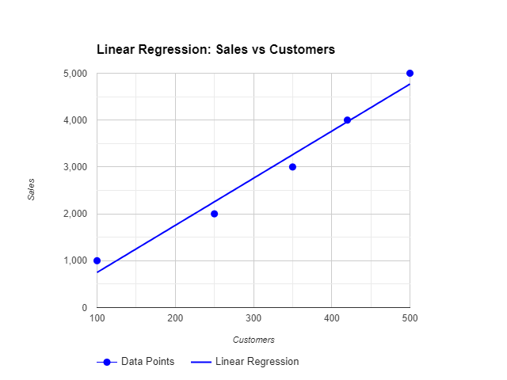
Output Of sales prediction using R script in R Studio:
The graph shows a linear regression model that predicts sales based on the number of customers. The blue dots represent individual data points, while the blue line represents the regression line. The slope of the line indicates the relationship between sales and customers. In this case, the slope is positive, suggesting that as the number of customers increases, so does sales.

Slide 3
Output Of sales prediction using Python script :
The graph shows a scatter plot of actual versus predicted values from a linear regression model. The x-axis represents the actual values, and the y-axis represents the predicted values. The blue line represents the regression line, which indicates the model's predictions. The closer the points are to the line, the better the model's performance. In this case, the points are clustered around the line, suggesting that the model is making reasonably accurate predictions. However, there is also a degree of scatter, indicating that the model may not be perfect in predicting all values.

Slide 4
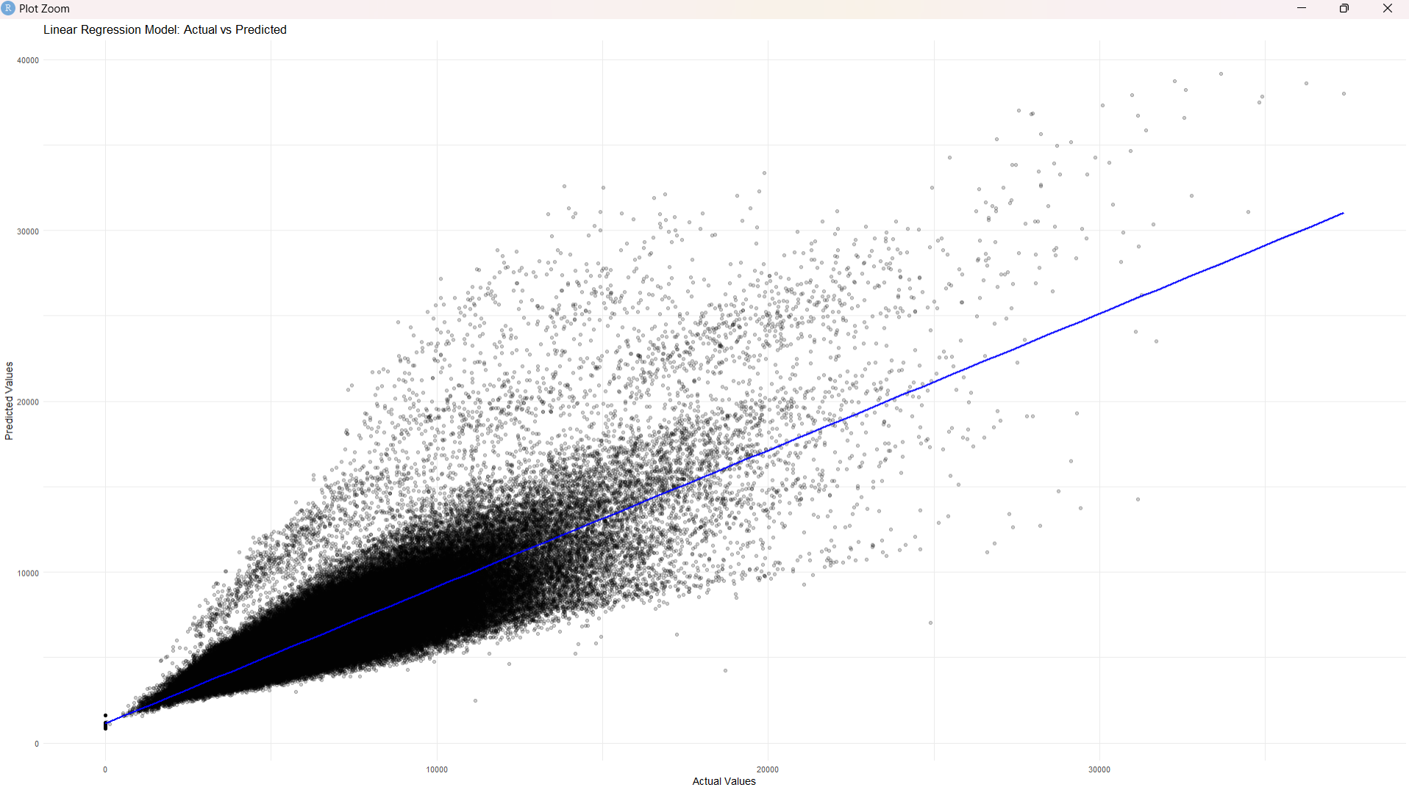

Slide 5
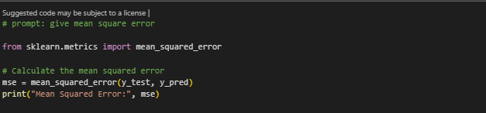
Mean square error(MSE):

Slide 6
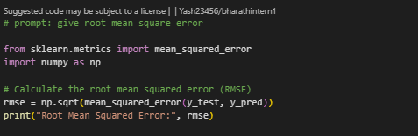
Root Mean Square Error (RMS)

Slide 7
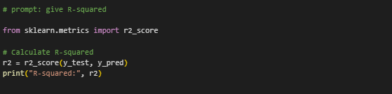
R-squared:

Slide 8
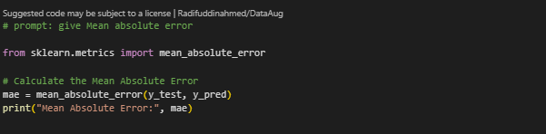
Mean Absolute Error:

Slide 9

Conclusion
The analysis demonstrates how both R and Python can be utilized for accurate sales prediction using linear regression models. The results reveal a positive correlation between customer numbers and sales, with the linear models capturing this relationship effectively. However, minor discrepancies in predictions indicate that the model can be further optimized. Performance metrics like Mean Squared Error (MSE) and R-squared validate the model's accuracy, yet also highlight areas for improvement. Overall, predictive analytics provides valuable insights for retail, aiding in decision-making and sales forecasting.

